Slide 1

Blinkit – Instant Delivery Demand Forecast & Dark Store Optimizations
Skills Used – Python, Pandas, Numpy, Matplotlib, Seaborn

Slide 2
Problem Statement
Q.1 Hourly demand analysis .
Q.2 City Level Demand Analysis.
Q.3 Store Performance (Demand per store).
Q.4 SKU Category Demand (Stock keeping unit).
Q.5 Daily Revenue Calculations.
Daily Revenue analysis.
Peak and low revenue days.

Slide 3
Business Problem
Q.5 Cancellation Insights.
Q.6 Zones with high cancellations.
Q.7 Does delivery time cause cancellations.
Q.8 Correlation Analysis (Delivery Time, Distance, Price.

Slide 4
Dataset Overview
Orders, timestamps, customer & store locations
Product categories & pricing
Delivery times & distances
Status (delivered/cancelled)
Suitable for forecasting and operational optimization

Slide 5
Key Insights Summary
Most of the orders are In Morning 5 AM – 8 AM and in Evening 5 PM – 10 PM.
All stores are getting almost equal number of orders.
After the analysis Grocery is the top selling Items then after
Household<Fruits<Snacks<Beverages<Personal care<Dairy etc.
After the calculating Revenue of the November month Date 2025-11-09 is the Day when Revenue generates more.
Most of the cancellations are In Morning 5 AM – 8 AM and in Evening 5 PM – 10 PM.
Zone Z-24 and Z-17 is that zone where cancellations is more.

Slide 6
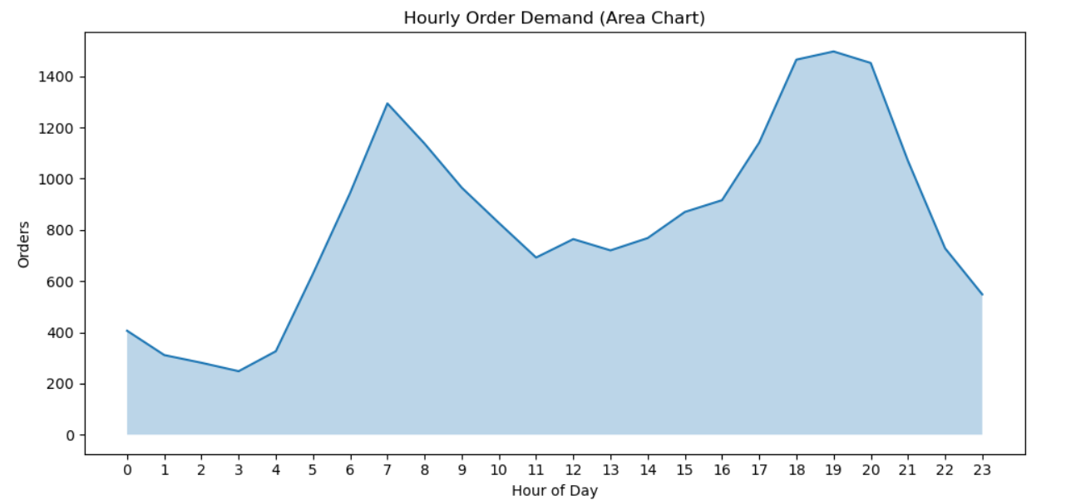
Hourly Demand Analysis

Slide 7
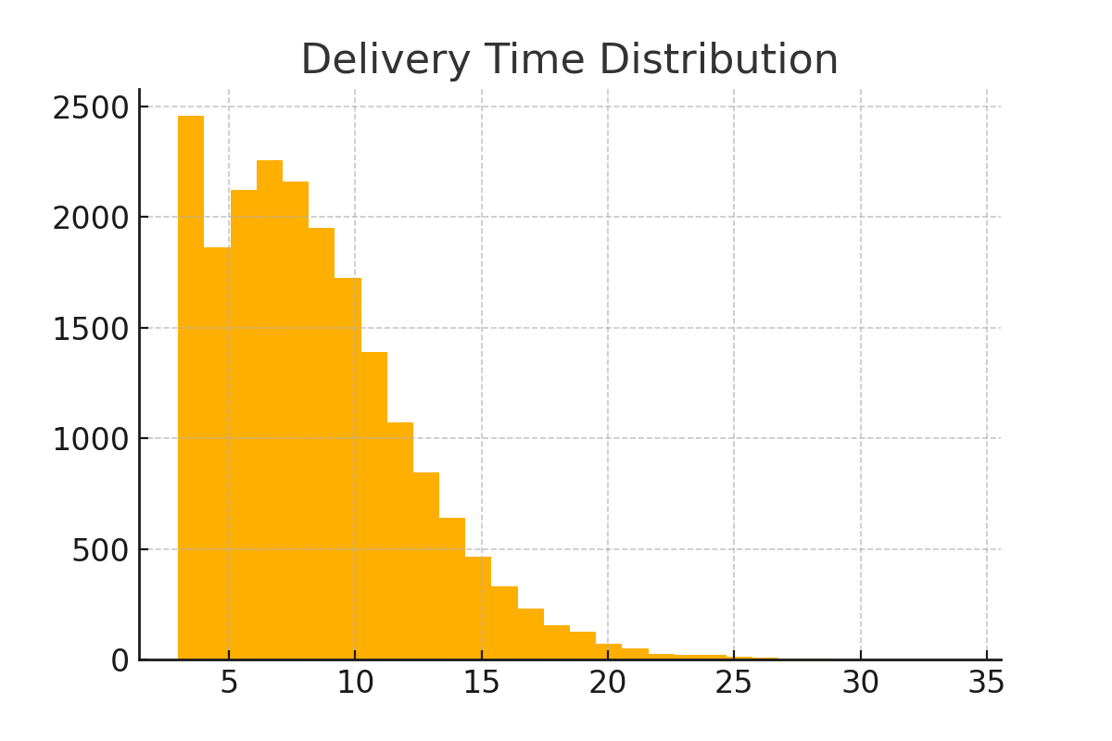

Slide 8
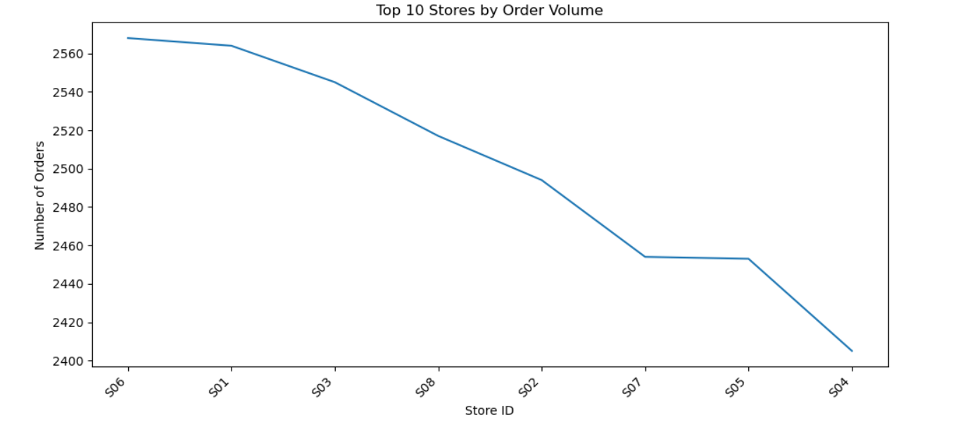
Top 10 Store By Order Volume

Slide 9
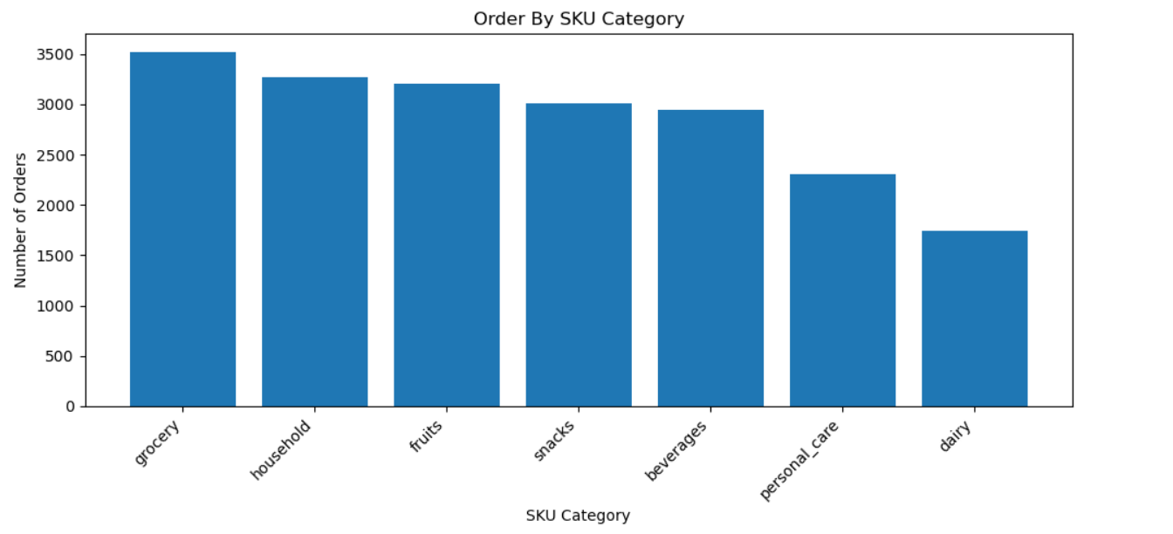
Top Selling Items Category

Slide 10
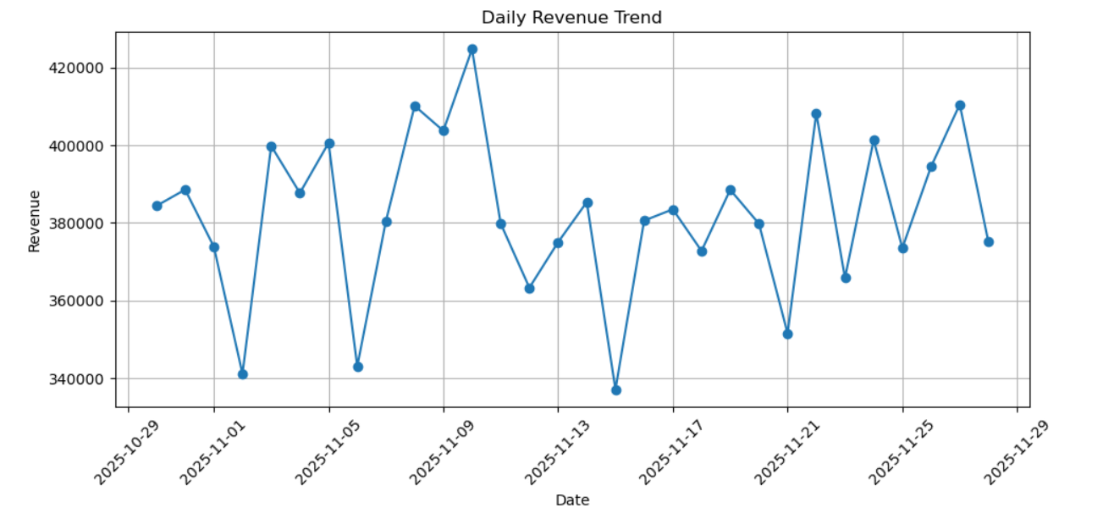
Daily Revenue Trend

Slide 11
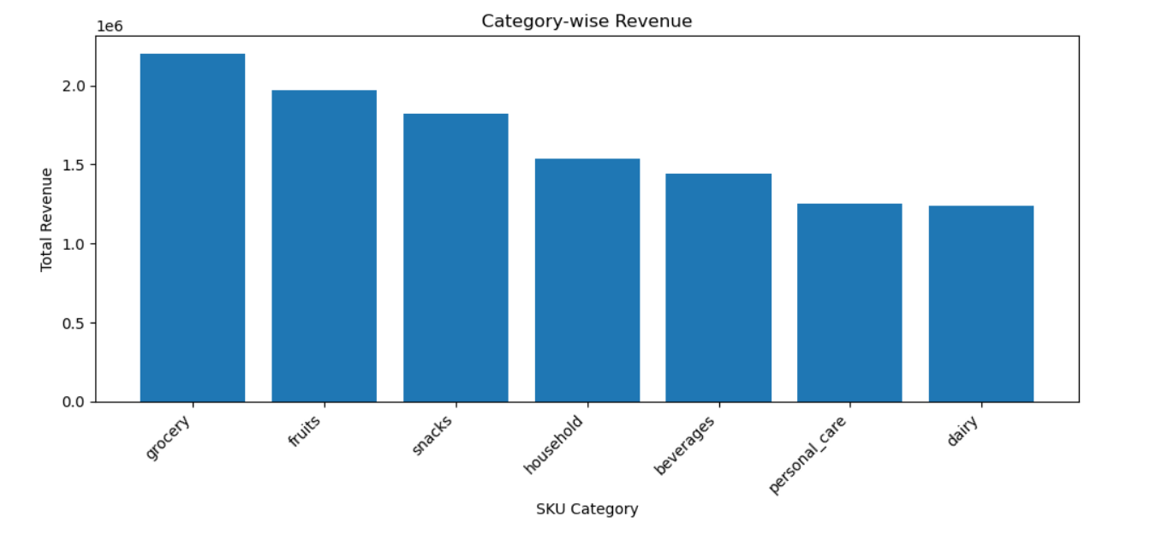
Category Wise Revenue

Slide 12
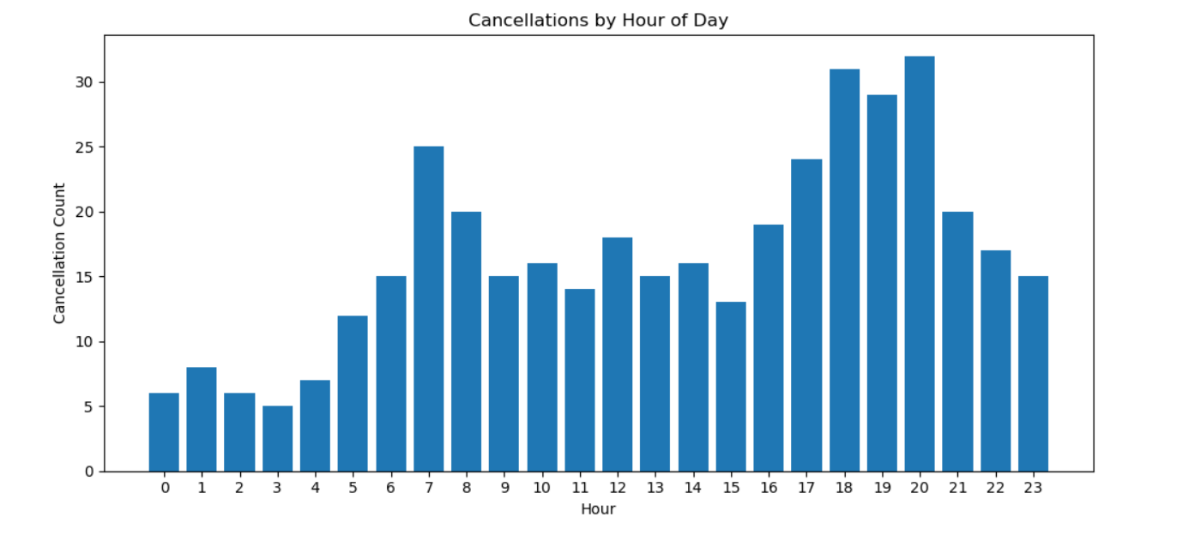
Cancellations By Hour Of Day

Slide 13
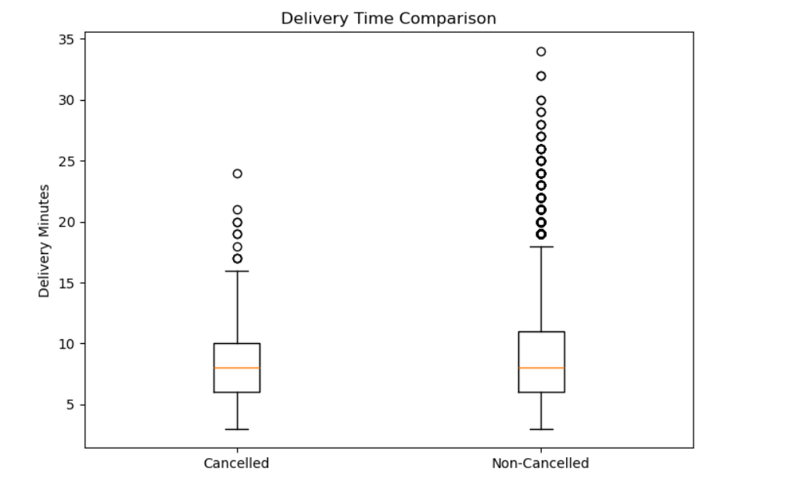
Delivery Time Comparison

Slide 14
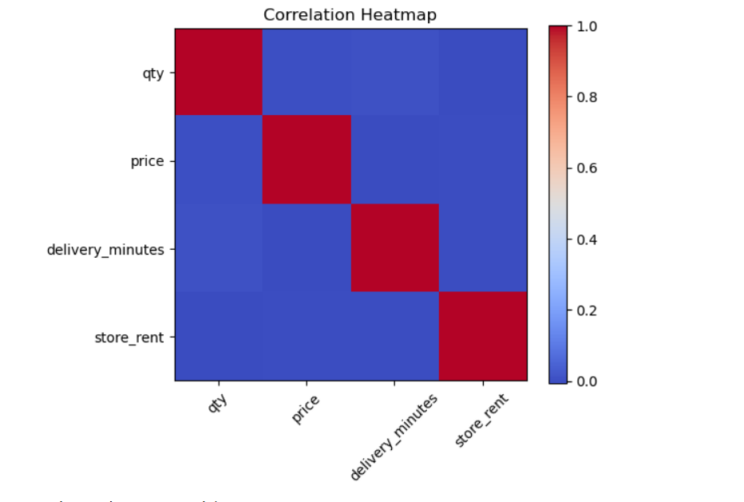
Correlation Analysis

Slide 15
Business Recommendations
Increase rider availability in peak hours.
Improve delivery speed in slow-performing zones.
Focus inventory on high-selling categories.
Relocate or optimize underperforming stores.
Open new stores in underserved demand clusters.
Reduce SLA (Late Delivery) breaches to lower the cancellations rates.

